Slide 1
Women Safety Band Using Internet Of Things
Team Name: Embedded bees
Team members:
Pranjali Dilip Gaidhani.
Prajakta Dattatraya Metil.
Gouri Bhagawant Kumbhar.
Theme : Women Safety.

Slide 2
What is the Problem Statement
The aim of this project is to develop a self defense system especially for women to protect themselves from present day physical harassments.
It has wide range of features and functionality like providing instant location of distress victim to the predefined number as soon as the emergency switch is pressed or if someone else tries to remove it forcefully.
This would help to reduce crime against women.

Slide 3
How are we going to implement our IDEA
This system is capable of monitoring the state of user’s body using heartbeat sensor and temperature sensor.
It is also used full for physically weak user because we use emergency shock system.it is affordable since make use of our Smartphone which has inbuilt GPS and we are using WI-FI module by taking Hotspot.
By using concept of IOT reliability of sensors to real time system be increased.

Slide 4
Technology used
Aurdino-Atmega328
GPS
GSM
Wi-Fi module
Temperature sensor
Heartbeat sensor
Panic switch button
Relay driver

Slide 5
How much of the Project is done
Block diagram
Circuit diagram
Source code(program)
simulation

Slide 6
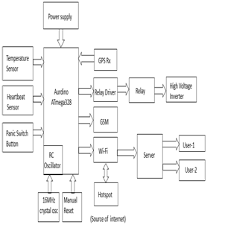
Block Diagram

Slide 7
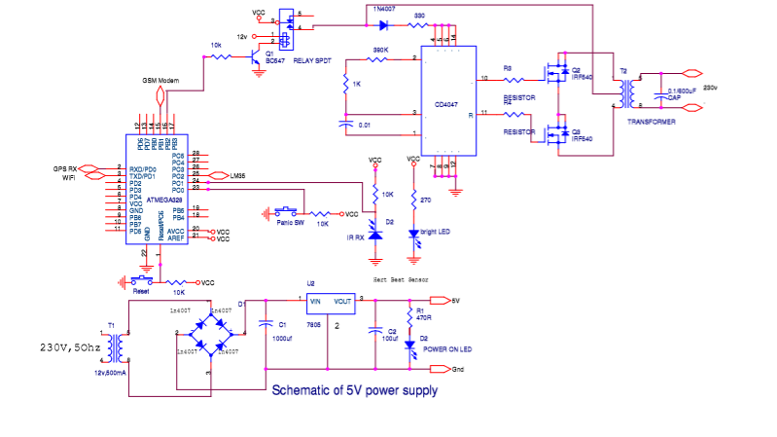
Circuit Diagram

Slide 8
Future plans
This device can be compatible with mobile phones
Voice message can be sent during need
Voice recorder and camera can also be added to the system.

Slide 9
Open source program
unsigned int dist,adc,ms=1234;
unsigned int temp,j;
unsigned int x0,y0,x1,y1;
unsigned char txt1[7],txt2[7],error,latti[]="1234.1234",longi[]="1234.1234";
unsigned char gps_data[301],flag=0;
unsigned int adc_data1,adc_data2,i;
char txt[]="1234567890ABCDEFGH";
sfr sbit m1 at PORTB0_bit;
sfr sbit m1_dir at DDB0_bit;

Slide 10
void main()
{
ADC_Init();
m1_dir=1;
m1=0;
Soft_UART_Init(&PORTD,6,7,9600,0);
Uart1_Init(9600);
/* Uart1_Write_Text("AT+CWQAP\r\n");// disconnect wifi
delay_ms(2000); // 2 sec delay
Uart1_Write_Text("AT\r\n");// Attention
delay_ms(2000); // 2 sec delay
Uart1_Write_Text("AT+RST\r\n");// Reset Wifi Module
delay_ms(5000); // 4 sec delay
Uart1_Write_Text("AT+CWMODE?\r\n");// returns Wifi Module mode
delay_ms(2000); // 2 sec delay
Uart1_Write_Text("AT+CWLAP\r\n");// list all AP
delay_ms(5000); // 2 sec delay
Uart1_Write_Text("AT+CWJAP=");// connect to softAP
Uart1_Write('"');// connect to softAP
Uart1_Write_Text("ACCESSPOINT");// connect to softAP

Slide 11
Uart1_Write('"');// connect to softAP
Uart1_Write_Text("ACCESSPOINT");// connect to softAP
Uart1_Write('"');// connect to softAP
Uart1_Write(',');// connect to softAP
Uart1_Write('"');// connect to softAP
Uart1_Write_Text("12345678");// connect to softAP
Uart1_Write('"');// connect to softAP
Uart1_Write_Text("\r\n");// Enter
delay_ms(15000); // 2 sec delay
Uart1_Write_Text("AT+CWJAP?\r\n");// check connectivity to softAP
delay_ms(5000); // 2 sec delay
Uart1_Write_Text("AT+CIFSR\r\n");// returns IP
delay_ms(5000); // 2 sec delay
Uart1_Write_Text("AT+CIPMUX=1\r\n");// -ESTABLISH MULTIPLE CONNECTION
delay_ms(2000); // 2 sec delay
Uart1_Write_Text("AT+CIPSERVER=1,80\r\n");// -START THE SERVER

Slide 12
while(1)
{
for(i=0;i<300;i++)
{
while(UART1_Data_Ready()!=1);
gps_data[i] =UART1_Read();
}
for(i=0;i<300;i++)
{
if(gps_data[i]=='$')
{
if(gps_data[i+1]=='G' && gps_data[i+2]=='P' && gps_data[i+3]=='R' )
i=i--;
i=i+21;//CHNGED
Uart1_Write_Text("AT+CIPSEND=0,21\r\n");
//Delay_ms(2000);
UART1_Write_Text("\r\nLattitude:");
for(j=0;j<9;j++)
{
UART1_Write(gps_data[i+j]);
latti[j]=gps_data[i+j];
}

Slide 13
// Delay_ms(2000);
Uart1_Write_Text("AT+CIPSEND=0,21\r\n");
// Delay_ms(2000);
UART1_Write_Text("\r\nLongitude:");
i=i+13; //CHENGD
for(j=0;j<9;j++)
{
UART1_Write(gps_data[i+j]);
longi[j]=gps_data[i+j];
}
Uart1_Write_Text("\r\n");
adc=ADC_Read(0);
MS=ADC_Read(2);
adc=adc/2.049;
if(adc>25 || ms>512)
{
m1=1;
Uart1_Write_Text("AT+CIPSEND=0,15\r\n");
Delay_ms(2000);
UART1_Write_Text("\r\n I AM IN DANGER");
m1=0;
}
}

Slide 14
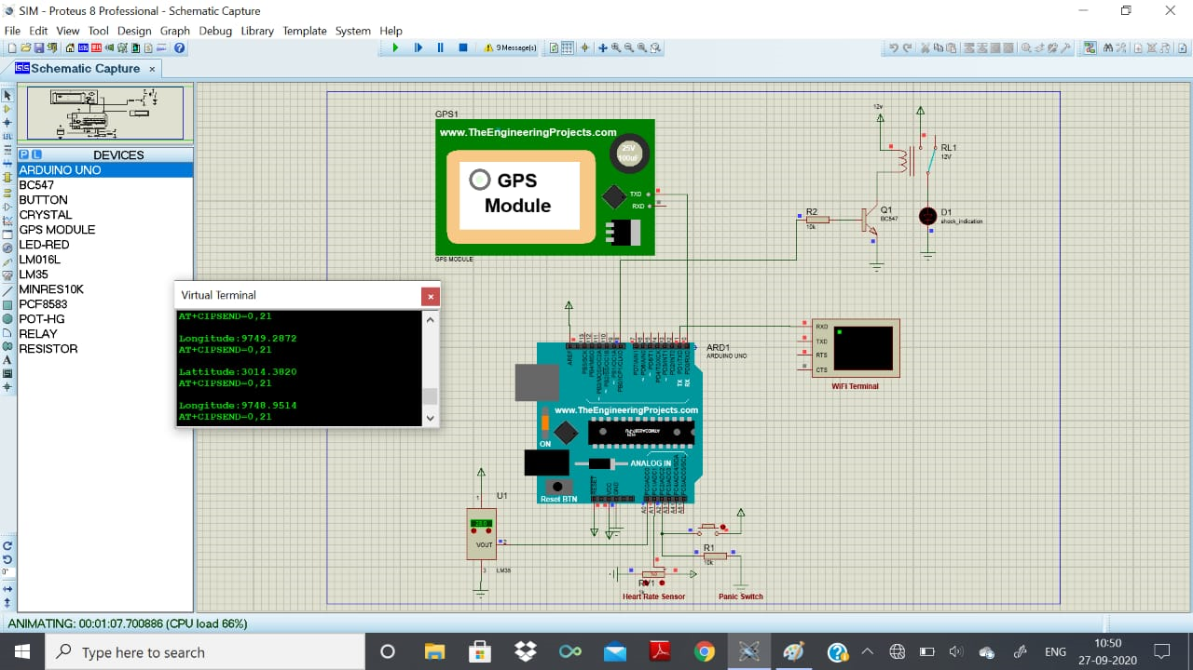
screenshot

Slide 15
Conclusion
In our system we developed one women self security smart band which contain temperature sensor, heartbeat sensor and panic button.
In this systems, sensors are continuously communicate with smartphone by using GSM and GPS modem.
It send emergency message automatically to the relatives, friends and near by police station. Our system is more efficient than other systems.

Slide 16
THANK YOU

